Slide 1

Transformation vs. Action internals

Slide 2
Components of Transformation functions
Input:
Initial data or variables to be transformed and analyzed.
Processing:
Operations performed on the input to achieve desired changes.
Output:
Transformed data or variables resulting from the processing step.

Slide 3
Components of Transformation functions
Parameters:
Variables or settings that control the transformation process.
Evaluation:
Assessment of the transformed data quality and effectiveness.

Slide 4
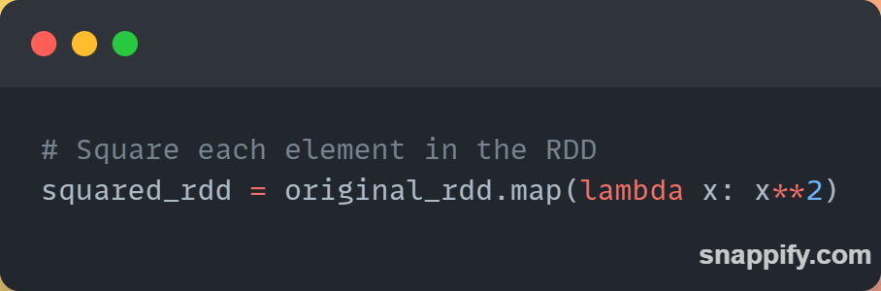
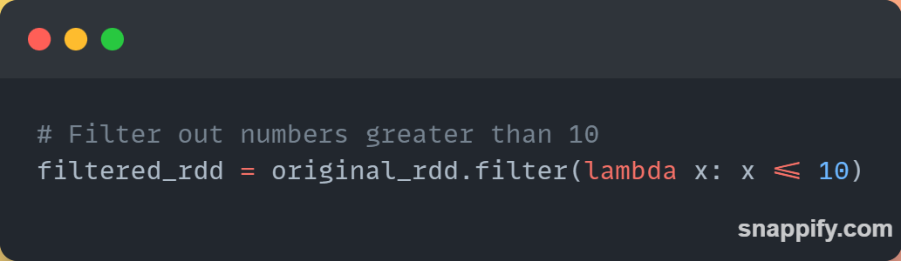
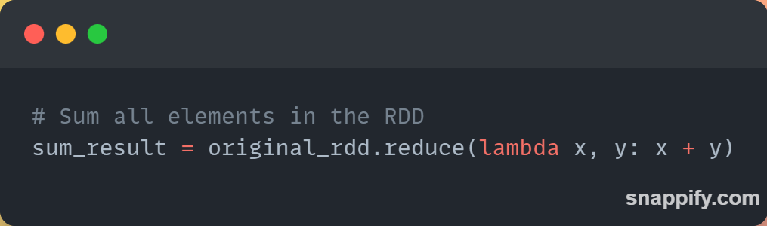
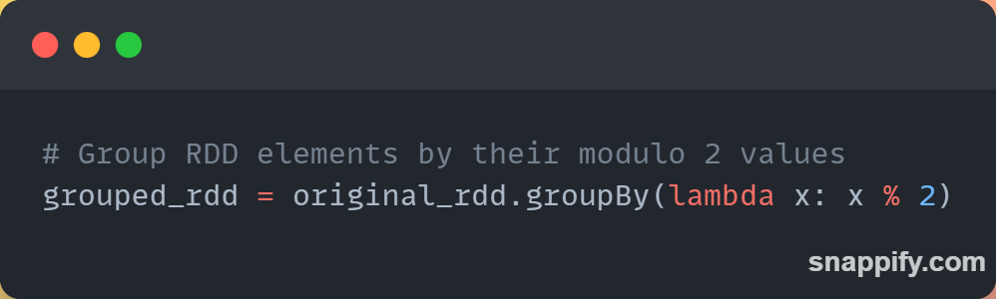
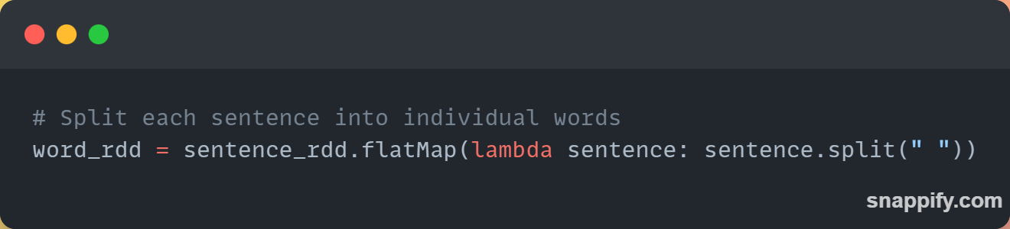
Examples
Map Transformation
Filter transformation
Reduce transformation
GroupBy transformation
FlatMap transformation

Slide 5
Components of Action functions
Result:
The action function returns a result or value based on the RDD or DataFrame.
Computation:
The action triggers the execution of the transformations defined on the RDD or DataFrame.

Slide 6
Components of Action functions
Aggregation:
Action functions often perform aggregations or
calculations on the data.
Communication:
Action functions collect and transmit the results back to the driver program.
Termination:
The execution of action functions marks the end of a Spark job or task.

Slide 7
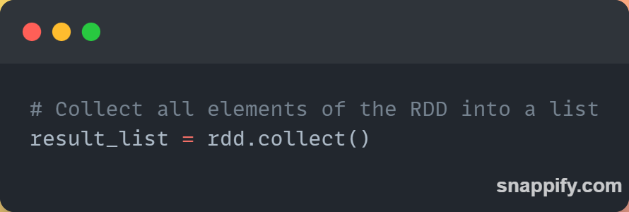
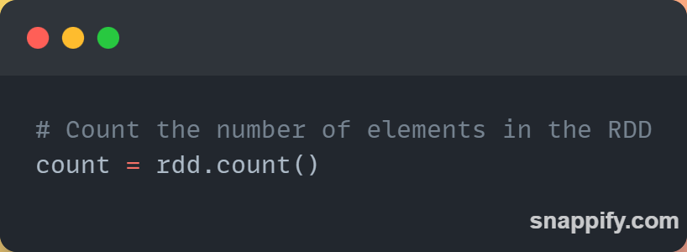
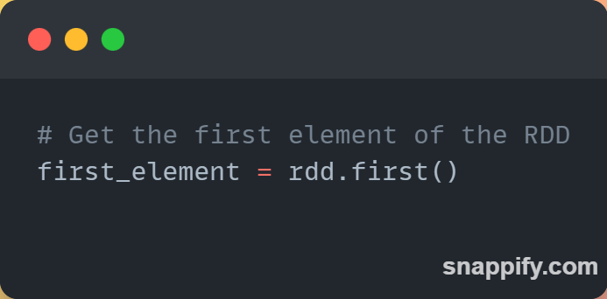
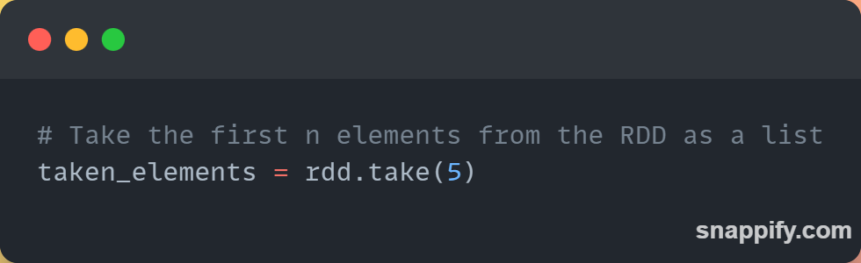
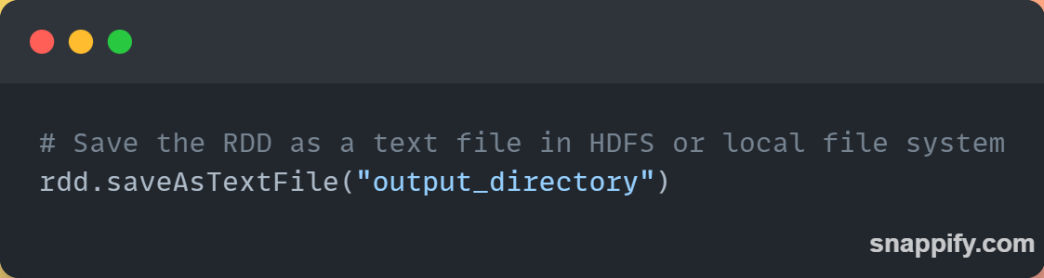
Examples
Collection action
Count action
Fist action
Take action
Save action

Slide 8

Next…

